Slide 1
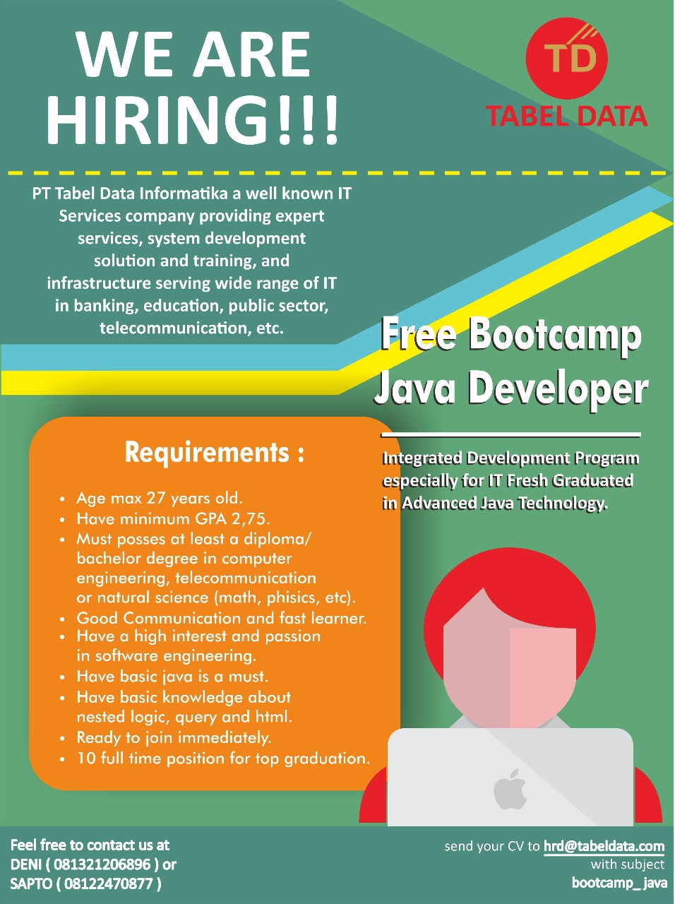
Bootcamp Java Developer #Day 5
PT. Tabel Data Infromatika
By Dimas Maryanto,S.Kom

Slide 2
Angular2

Slide 3






Setup Development Environtment

Slide 4
Generate new project

Slide 5
Generate Components

Slide 6
Generate Modules

